Slide 1
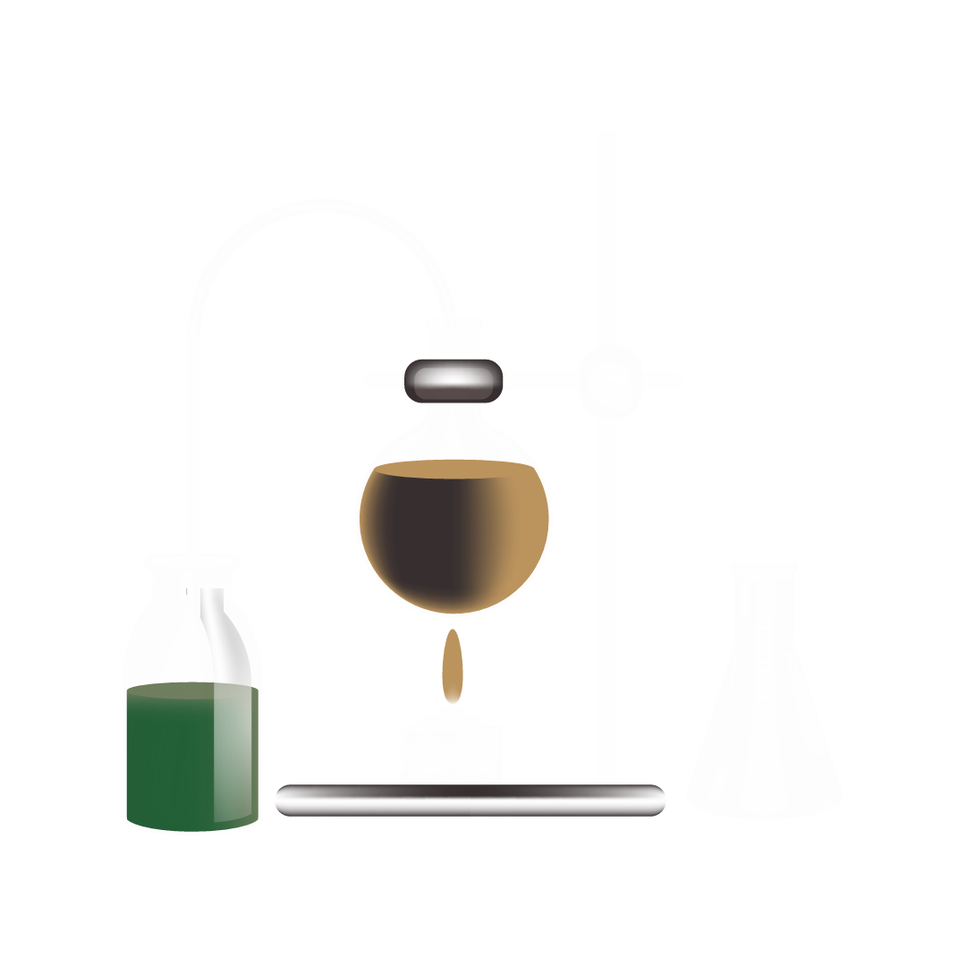

Biochemistry and Biomolecules Science
Here is where your presentation begins

Slide 2
Contents of this template
You can delete this slide when you’re done editing the presentation
Fonts | To view this template correctly in PowerPoint, download and install the fonts we used
Used and alternative resources | An assortment of graphic resources that are suitable for use in this presentation
Thanks slide | You must keep it so that proper credits for our design are given
Colors | All the colors used in this presentation
Icons and infographic resources | These can be used in the template, and their size and color can be edited
Editable presentation theme | You can edit the master slides easily. For more info, click here
For more info: Slidesgo | Blog | FAQs
You can visit our sister projects: Freepik | Flaticon | Storyset | Wepik | Videvo

Slide 3
Table of contents
I
II
III
IV
V
VI
Introduction
Carbohydrates
Proteins
You can describe the topic of the section here
You can describe the topic of the section here
You can describe the topic of the section here
Nucleic acids
Biotechnology
Conclusion
You can describe the topic of the section here
You can describe the topic of the section here
You can describe the topic of the section here

Slide 4

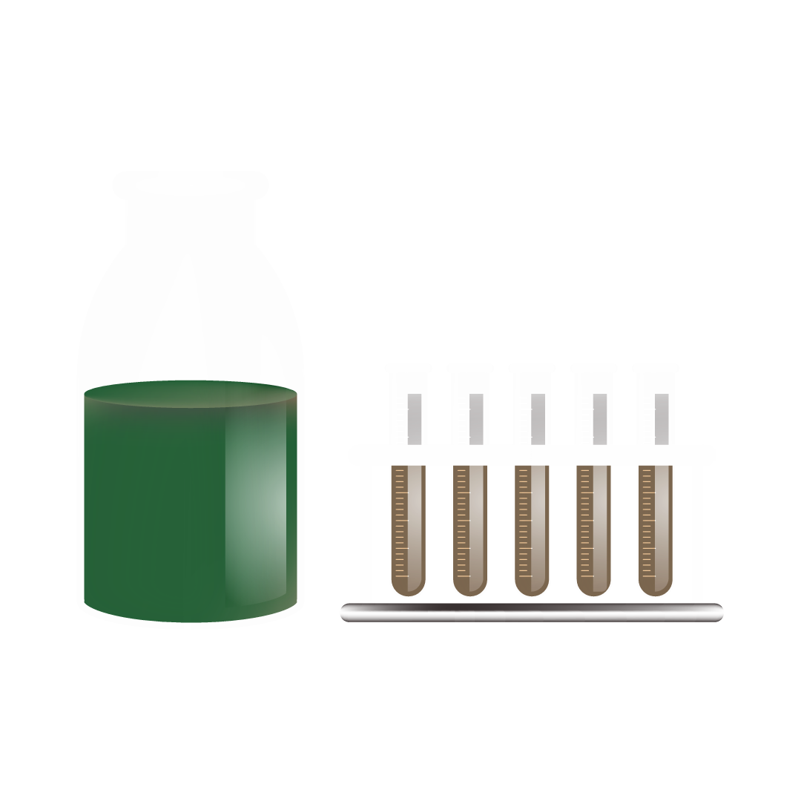
Whoa!
This can be the part of the presentation where you introduce yourself, write your email…

Slide 5
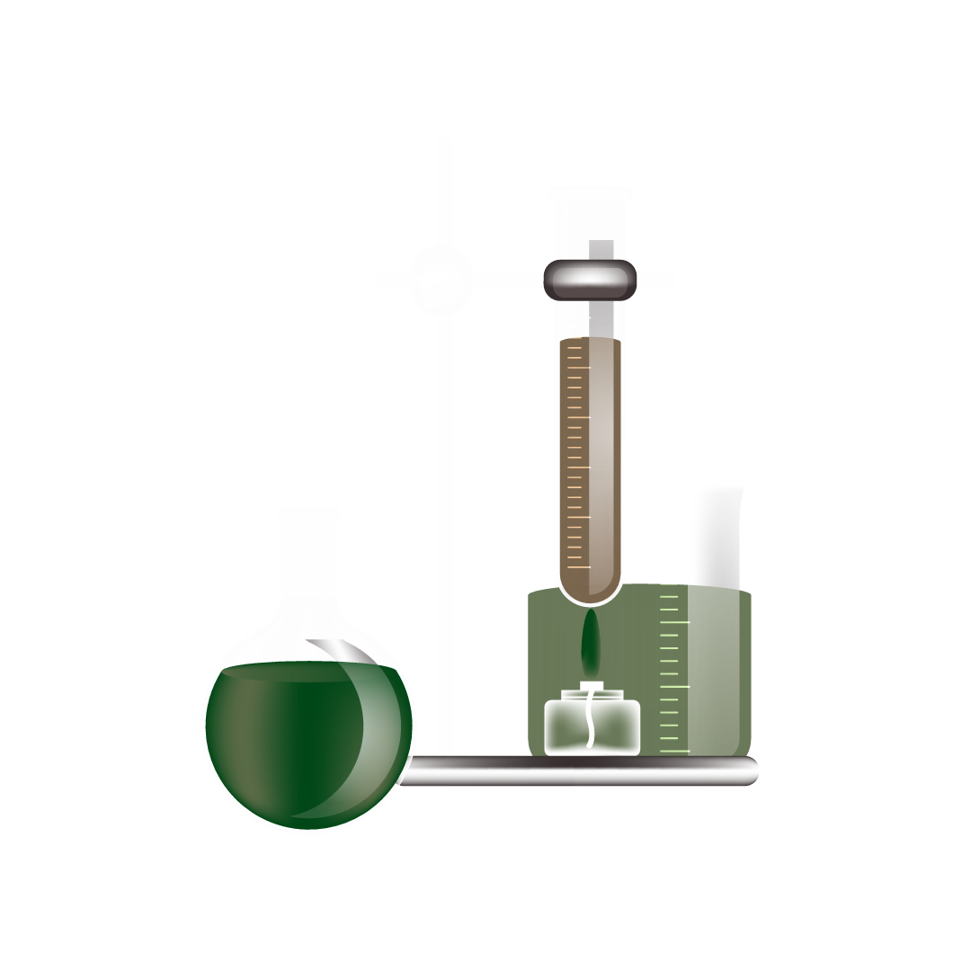

I
Introduction
You can enter a subtitle here if you need it

Slide 6
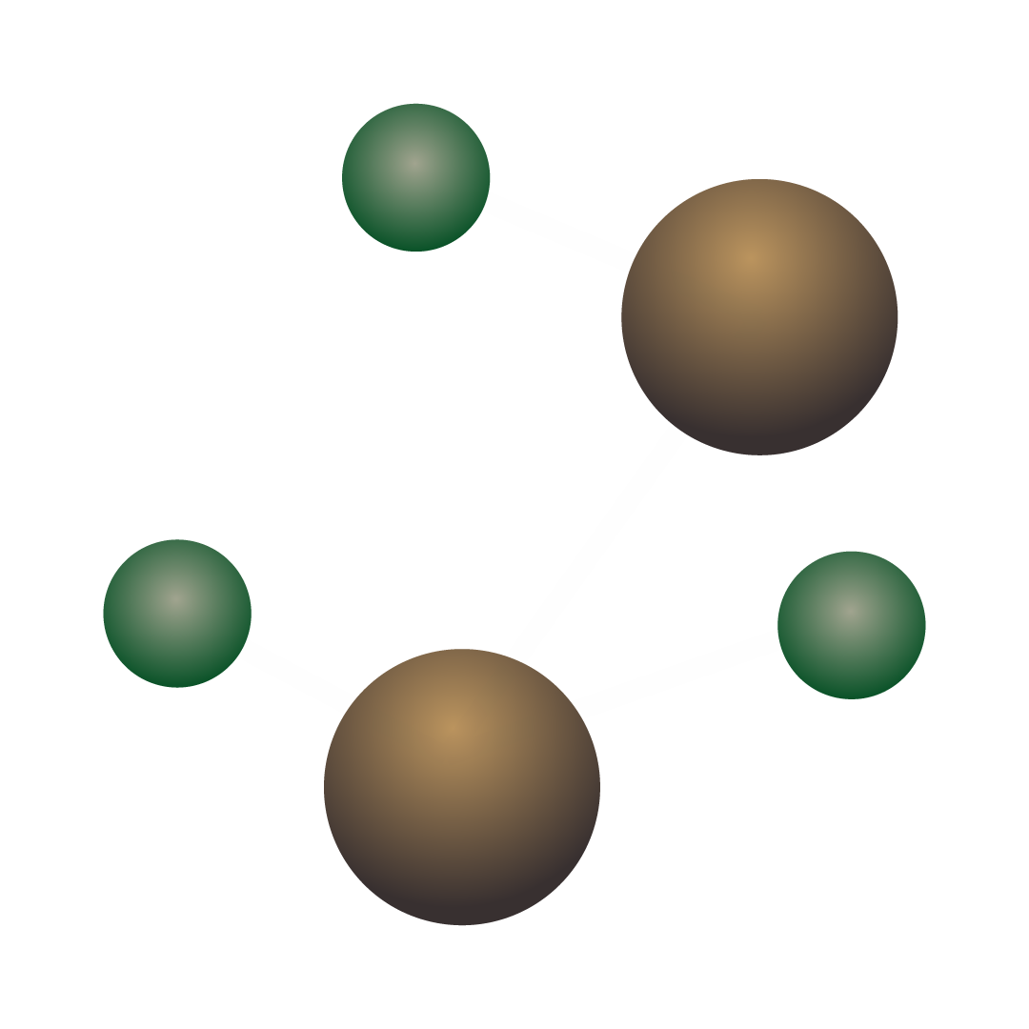
From molecules to life
Mercury is the closest planet to the Sun and the smallest one in the entire Solar System. Contrary to popular belief, this planet's name has nothing to do with the liquid metal. Mercury was, instead, named after the famous Roman messenger god Mercurius
Mercury takes a little more than 58 days to complete its rotation, so try to imagine how long days must be there! Since the temperatures are so extreme, albeit not as extreme as on Venus, Mercury has been deemed to be non-habitable for humans

Slide 7
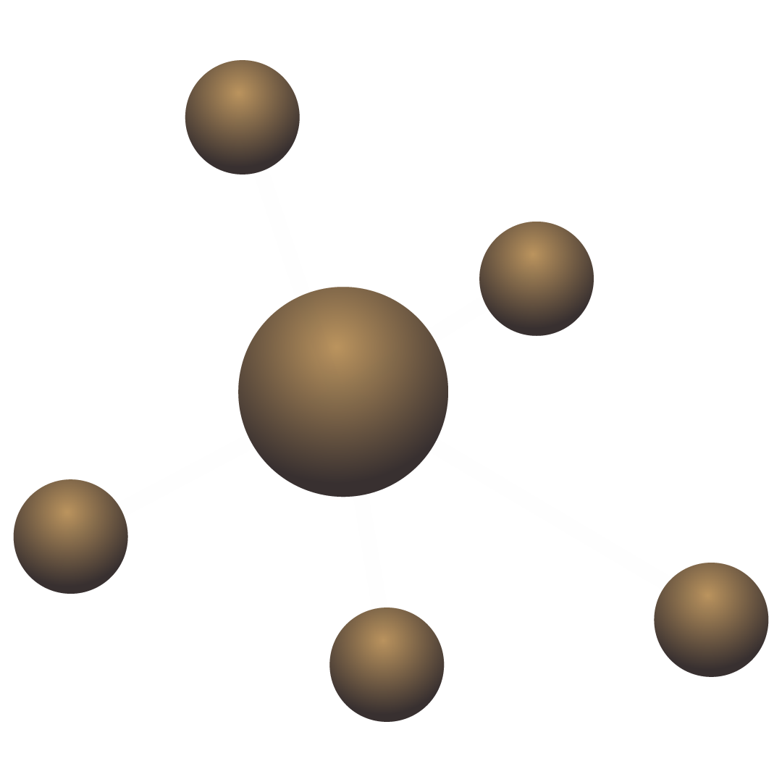
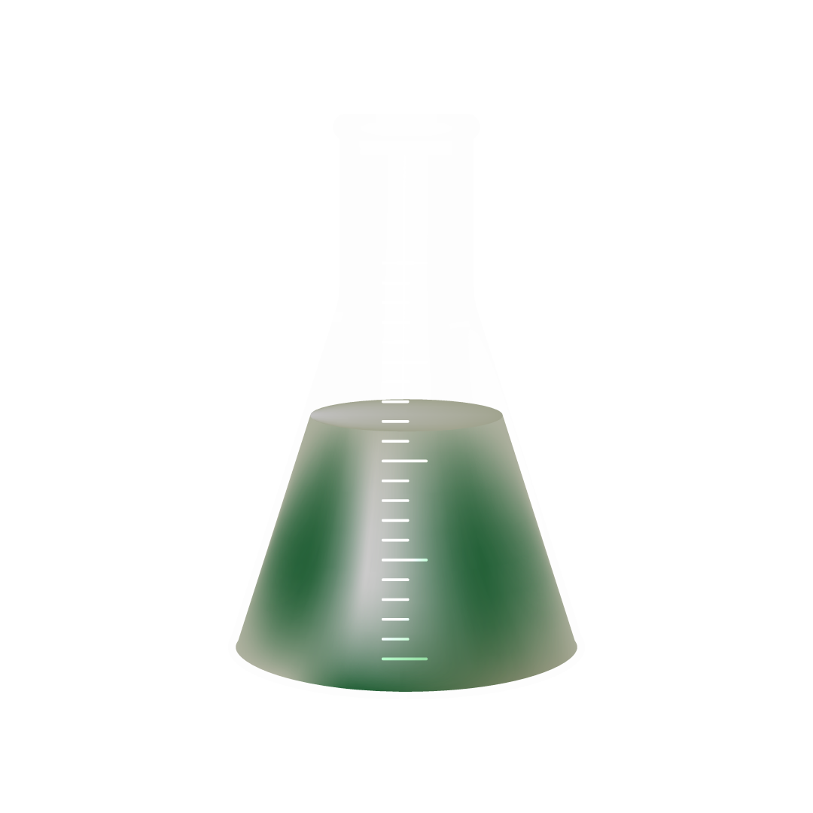
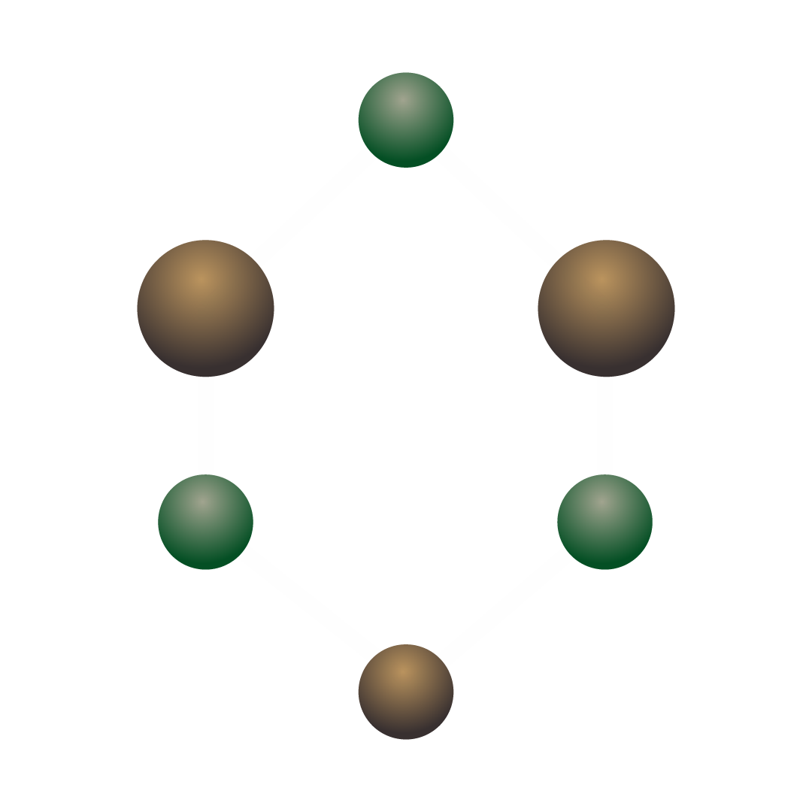
Introduction to biochemistry
Do you know what helps you make your point crystal clear? Lists like this one:
They’re simple
You can organize your ideas clearly
You’ll never forget to buy milk!
And the most important thing: the audience won’t miss the point of your presentation

Slide 8
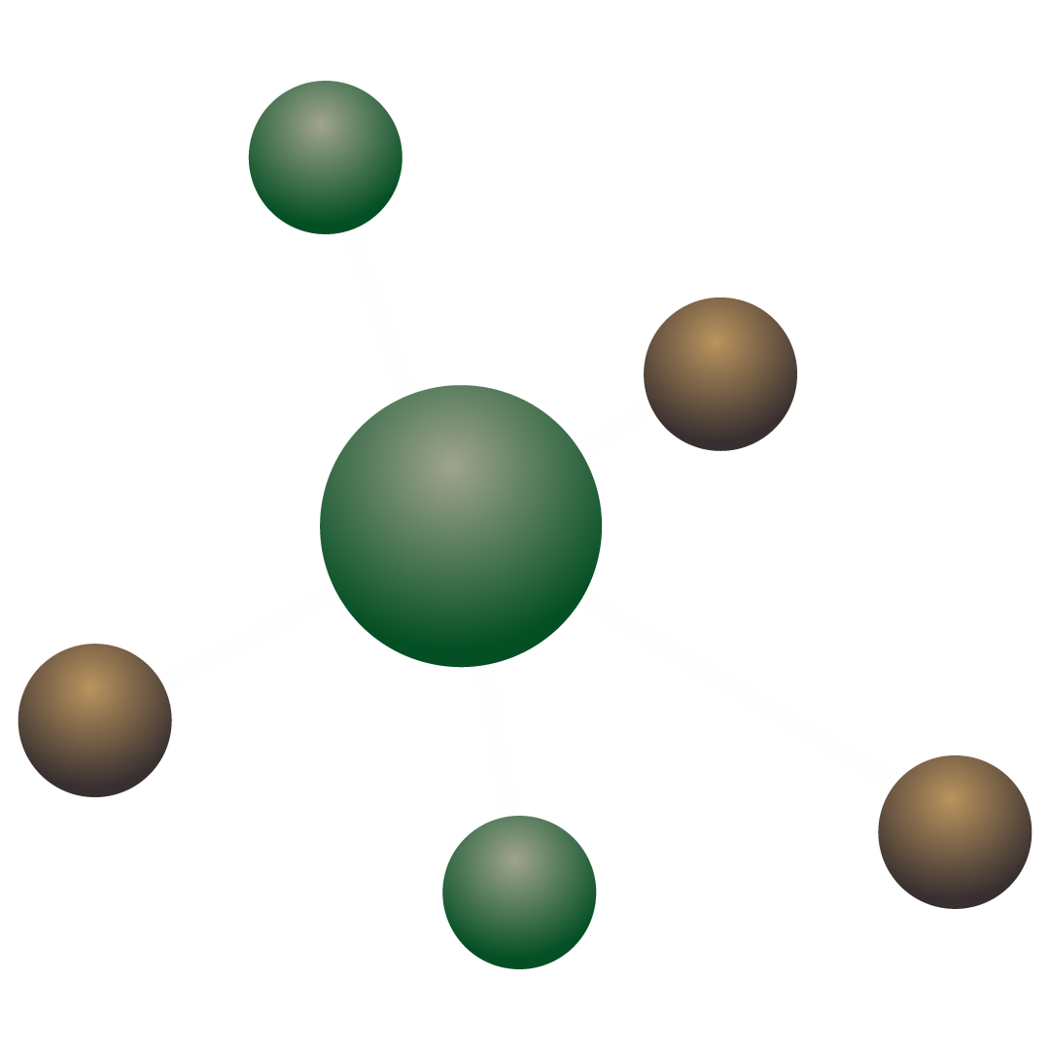
What are biomolecules?
Organic molecules
Inorganic molecules
Mercury is the closest planet to the Sun and the smallest one in the Solar System—it’s only a bit larger than the Moon
Venus has a beautiful name and is the second planet from the Sun. It’s hot and has a poisonous atmosphere

Slide 9
Key aspects of biochemistry
Chemical processes
Organic molecules
Medicine applications
Mercury is the closest planet to the Sun and the smallest of them all
Venus has a beautiful name and is the second planet from the Sun
Despite being red, Mars is actually a cold place. It’s full of iron oxide dust

Slide 10
Type of biomolecules
Carbohydrates
Proteins
Mars is actually a very cold place
Venus has extremely high temperatures
Lipids
Nucleic acids
Jupiter is the biggest planet of them all
Saturn is a gas giant and has several rings

Slide 11
Important functions
Give energy
Form cell walls
Catalyze reactions
Mars is actually a very cold place
Venus is the second planet from the Sun
Neptune is the farthest planet from the Sun
Protect organs
Cell production
Synthesis
Mercury is the closest planet to the Sun
Saturn is a gas giant with several rings
Jupiter is the biggest planet of them all

Slide 12
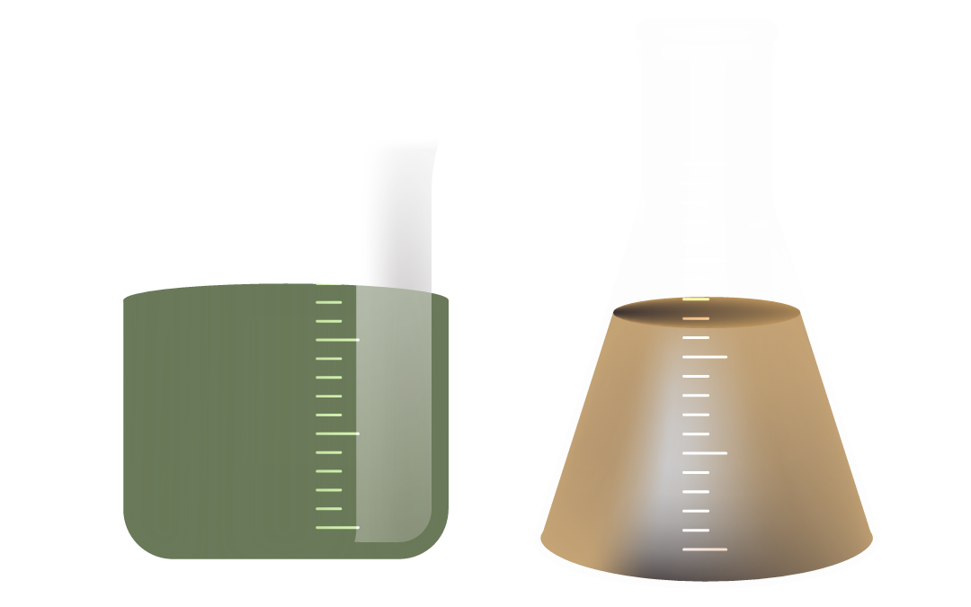
Awesome words

Slide 13
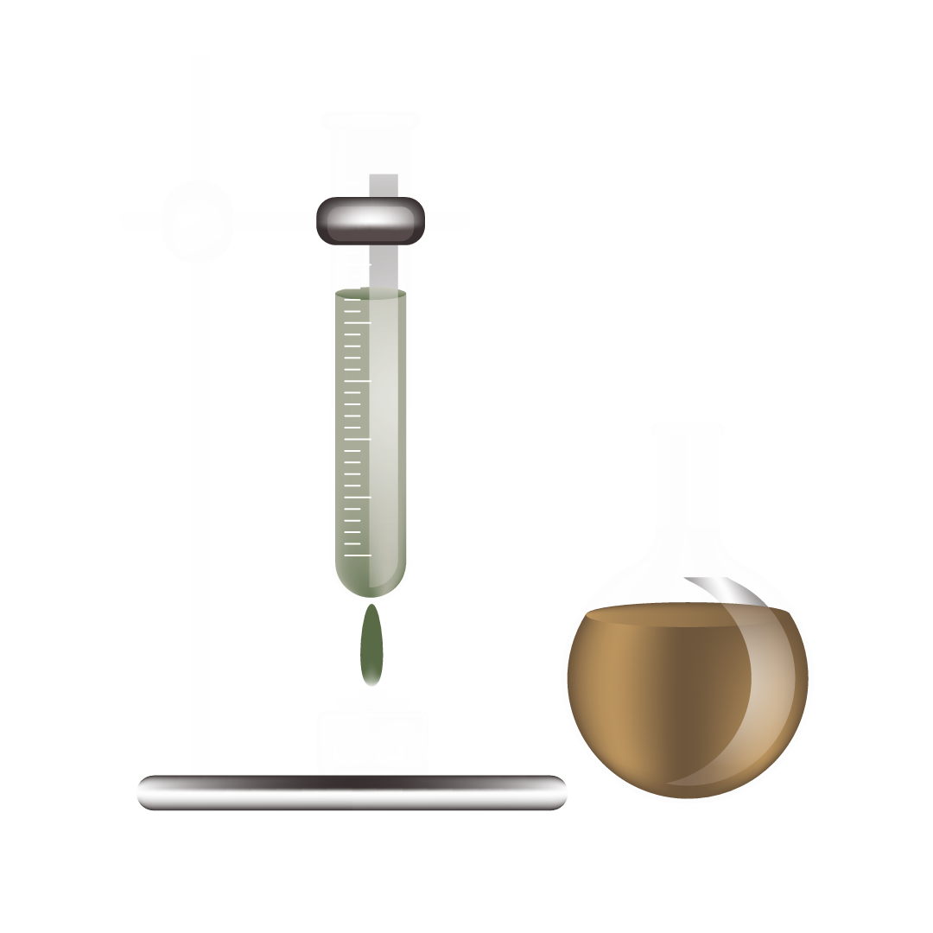

—Someone Famous
“This is a quote, words full of wisdom that someone important said and can make the reader get inspired”

Slide 14
Biomolecules & processes
Complete the following table with the data required
Function | Biomolecules involved | Examples of function
Energy source | Carbohydrates, fats
Catalysis |  | Accelerate chemical reactions in cells
Genetic information | Nucleic acids (DNA and RNA)
Structural support |  | Provide structure to tissues and organs; Carbohydrates form cell walls in plants

Slide 15
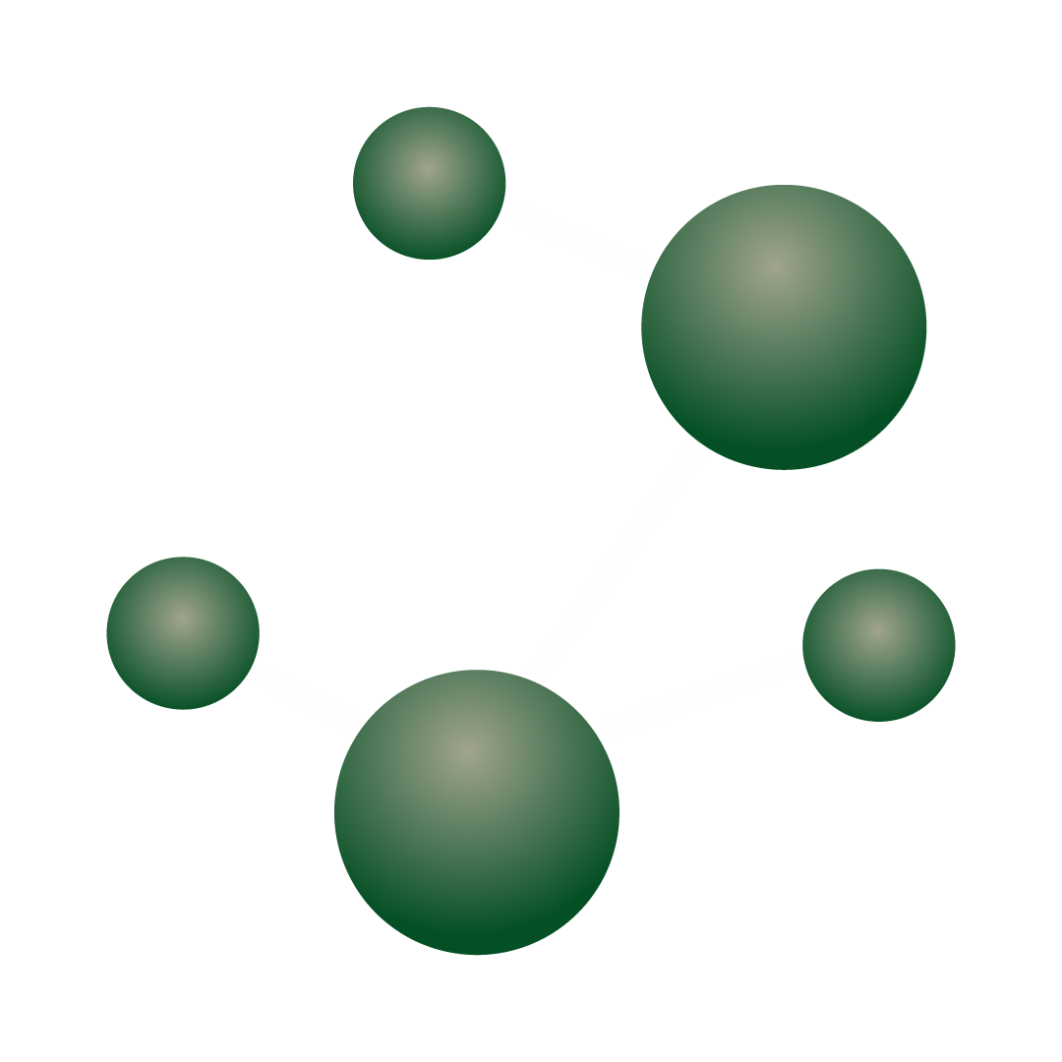
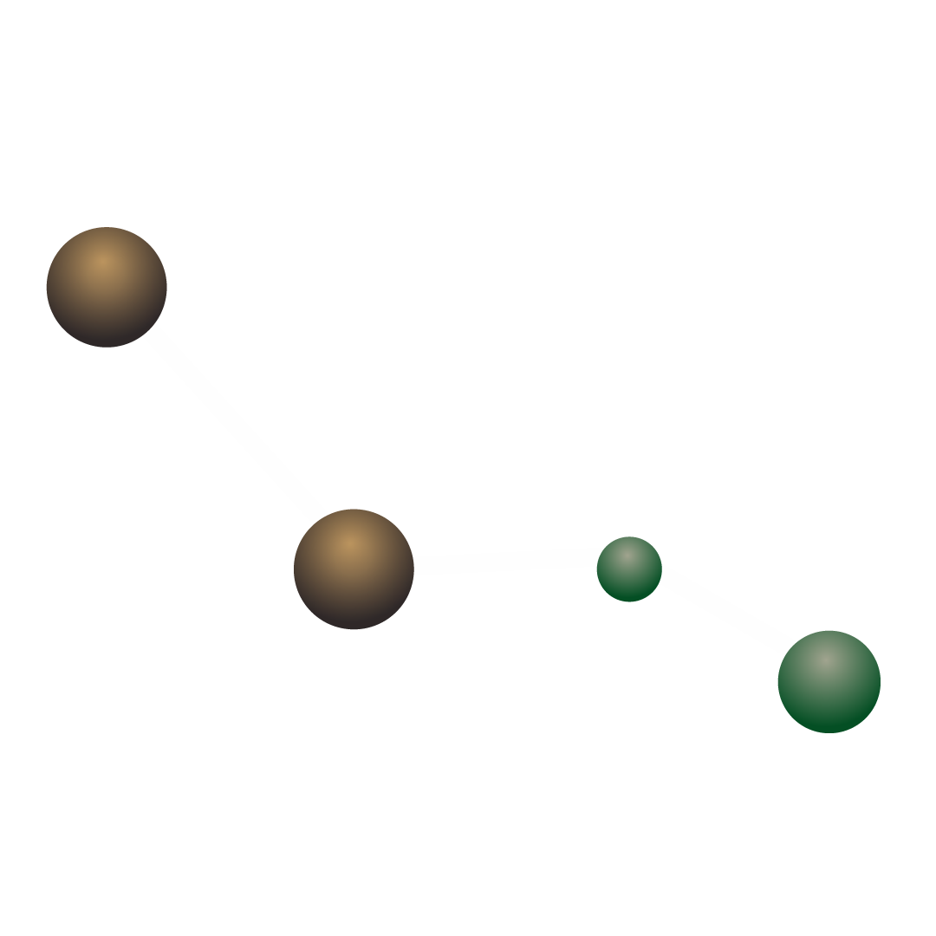
A picture always reinforces
the concept
Images reveal large amounts of data, so remember: use an image instead of a long text. Your audience will appreciate it

Slide 16
Most common elements
85%
70%
50%
Hydrogen
Oxygen
Carbon
Mercury is the closest planet to the Sun and the smallest of them all
Venus has a beautiful name and is the second planet from the Sun
Despite being red, Mars is actually a cold place. It’s full of iron oxide dust

Slide 17
True or false
Read the sentences and decide if they are true or false, then justify your answer
Statement | True or false
Enzymes are known to act as a structural component in cell membranes | False. Enzymes function as biological catalysts, facilitating and speeding up chemical reactions in cells
DNA and RNA are both types of nucleic acids involved in storing and transmitting genetic information | Write your answer here…
Carbohydrates are biomolecules that include sugars, starches, and cellulose, and they primarily serve as a long-term energy storage form | Write your answer here…

Slide 18
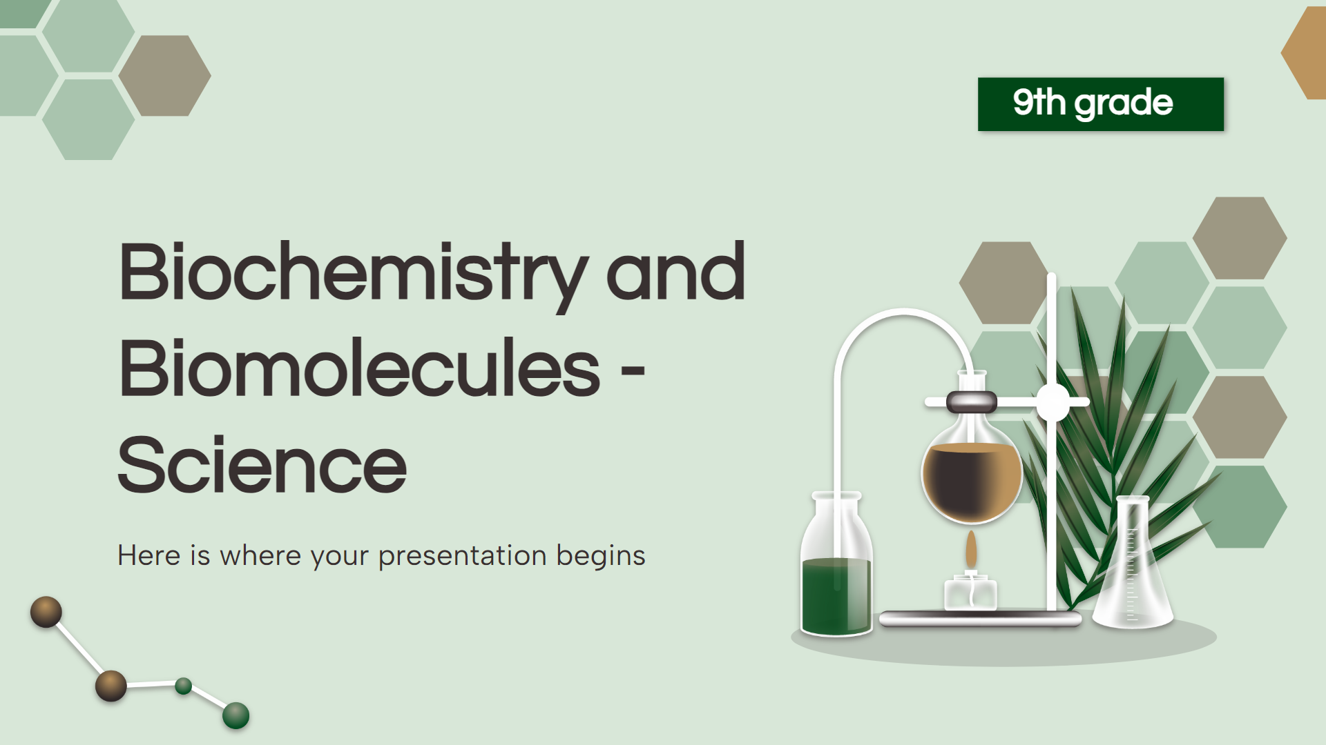
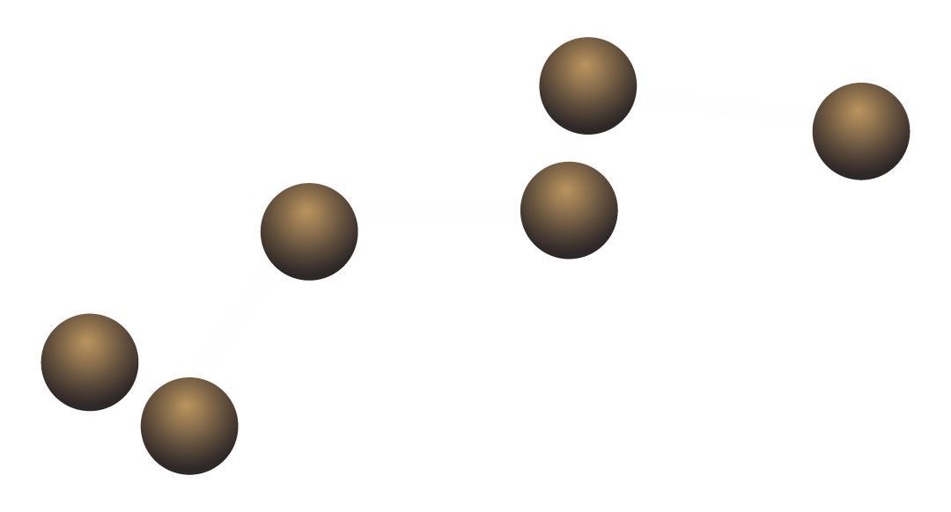
Computer mockup
You can replace the image on the screen with your own work. Just right-click on it and select “Replace image”

Slide 19
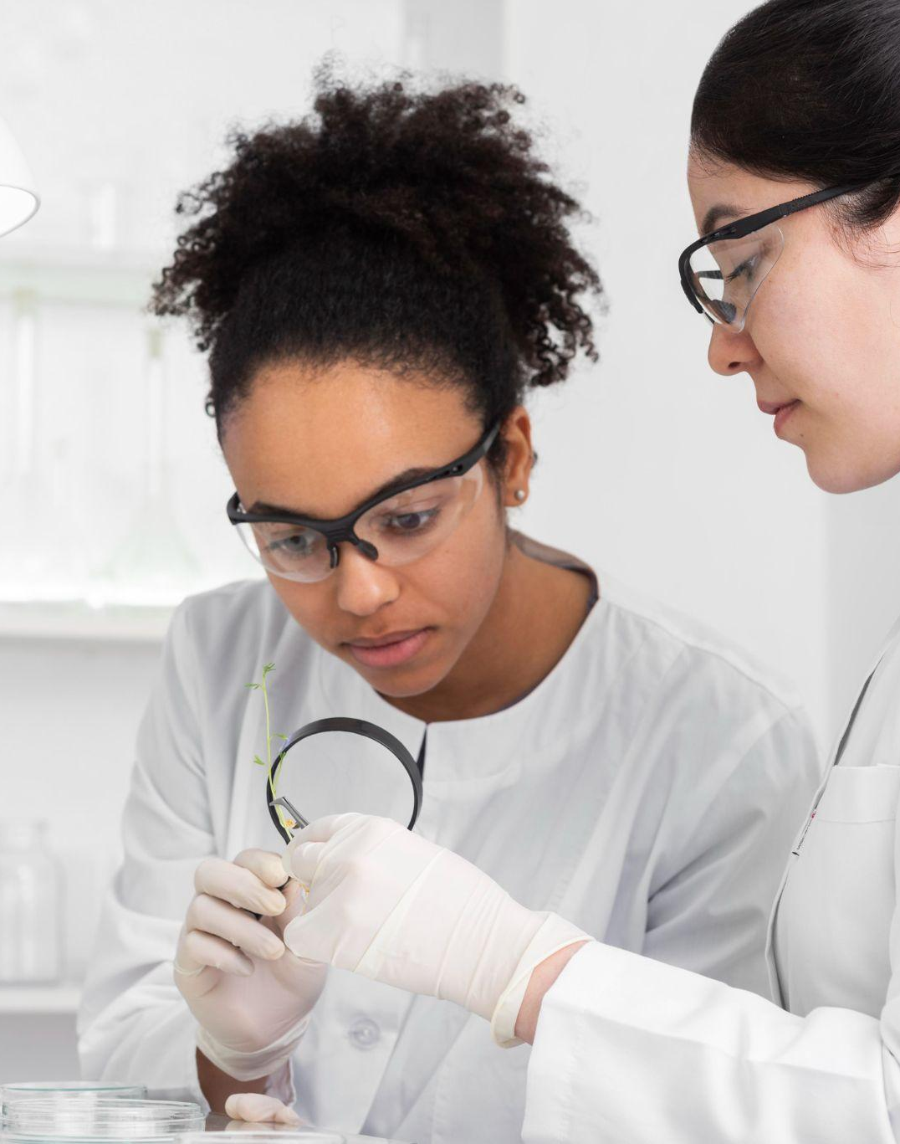
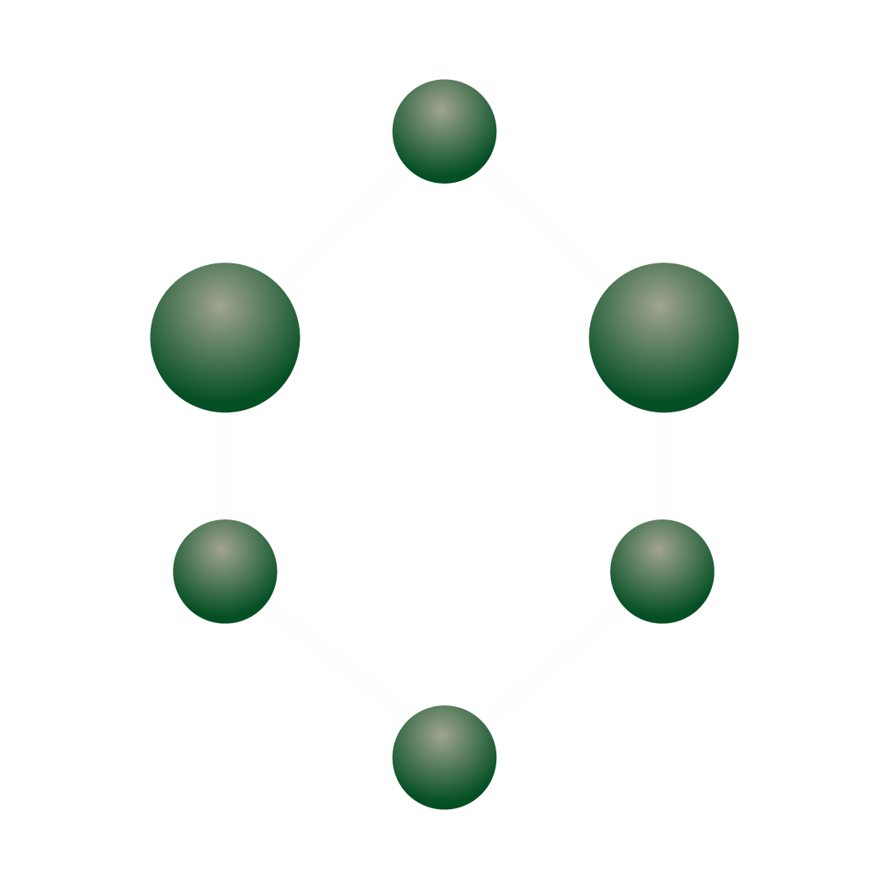
Tablet mockup
You can replace the image on the screen with your own work. Just right-click on it and select “Replace image”

Slide 20
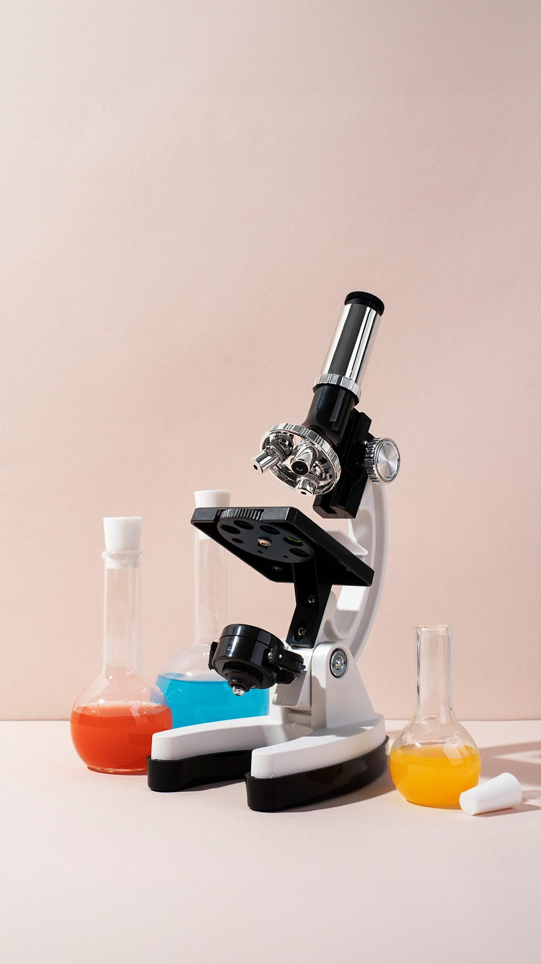
Phone mockup
You can replace the image on the screen with your own work. Just right-click on it and select “Replace image”

Slide 21
Countries and investigations
United States
Venus is the second planet from the Sun
England
Mercury is the closest planet to the Sun
Russia
Despite being red, Mars is a very cold place

Slide 22
A timeline always works well
Venus is the second planet from the Sun
Earth is the third planet from the Sun
Saturn was named after a Roman god
Urea synthesis
Double helix DNA
Polymerase chain
1828
1953
1985
1865
1977
2012
Inheritance
Sequencing proteins
CRISPR-Cas9
Mercury is the closest planet to the Sun
Jupiter is the biggest planet of them all
Neptune is the eighth planet from the Sun

Slide 23
Types of carbohydrates
Carbohydrates
Simple
Complex
Monosaccharides
Glycogen
Glucose, fructose
Fyber
Disaccharide
Starch
Maltose, sucrose

Slide 24
Characteristics of biomolecules
Biomolecule | Type | Classification | Examples | Elements
Carbohydrates | Monosaccharides | Monosaccharides, disaccharides, etc | Glucose, fructose, sacarose, etc | C, H, O
Lipids | Fatty acids | Phospholipids, steroids, triglycerides, etc | Oleic acid, palmitic acid, etc | C, H, O
Proteins | Amino acids | Fibrous or globular, simple or conjugate | Keratin, hemoglobin, actin, collagen | C, H, O, N, S
Nucleic acids | Nucleoids | DNA, RNA | Adenine, cytosine, guanine, timine, etc | C, H, O, N, P

Slide 25
Most abundant bioelements
C
Carbon
Mars is full of iron oxide dust
N
Nitrogen
Saturn has beautiful rings
H
Hidrogen
Earth is the planet with life
P
Phosphorus
Neptune is far away from us
O
Oxygen
Jupiter is a huge gas giant
S
Sulfur
Mercury is a very small planet

Slide 26
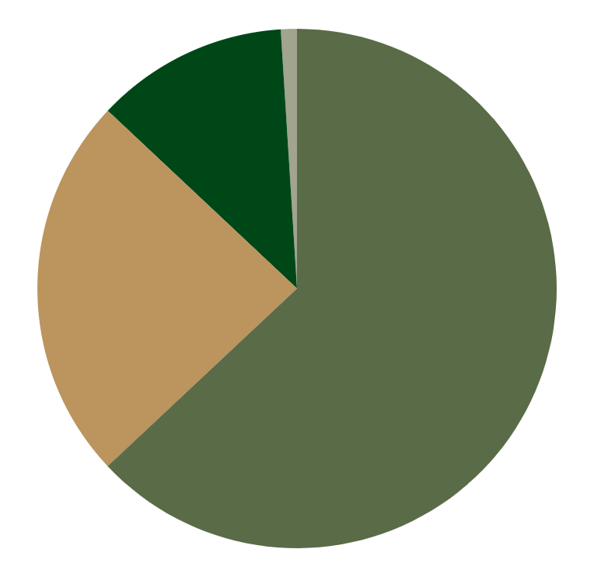
Human body’s elements
63%
24%
Hydrogen
Oxygen
7%
1%
Carbon
Others
Mercury is the smallest planet
Venus has very high temperatures
Jupiter is the biggest planet
Saturn is a gas giant with rings
Follow the link in the graph to modify its data and then paste the new one here. For more info, click here

Slide 27
Multiple choice
Read the following statements, choose the correct option and color it in brown using the fill color tool
I
Primary biomolecule source of quick and easily accessible energy for living organisms
Proteins
Carbohydrates
Nucleic acids
II
Biomolecule that acts as the hereditary material, storing and transmitting genetic information
Proteins
Carbohydrates
Nucleic acids

Slide 28
DNA and RNA
Function
I
II
DNA
RNA
Genetic blueprint of life
Store and transmit hereditary information from one generation to another
Gene expression and also protein synthesis
Transfer genetic information from DNA
Nucleic acids

Slide 29
Write an essay
The world of biomolecules and biochemistry is interesting! Write a short paragraph about the importance of biomolecules, their functions and the main bioelements
Type here your text…

Slide 30
Conclusions
Conclusion I
Conclusion III
Mercury is the closest planet to the Sun and the smallest of them all
Venus has a beautiful name and is the second planet from the Sun
Conclusion II
Conclusion IV
Jupiter is a gas giant and the biggest planet in the Solar System
Saturn is the second-largest planet in the Solar System

Slide 31

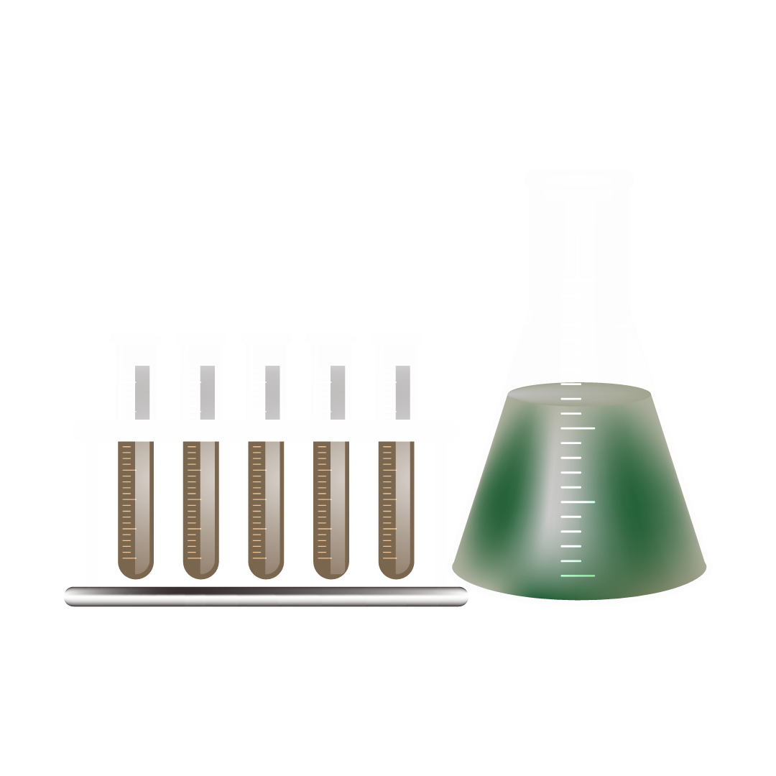
Thanks!
Do you have any questions?
youremail@freepik.com
+34 654 321 432
yourwebsite.com
Please keep this slide for attribution

